Slide 1




EagleSat
Flight Operations
Mo Sabliny

Slide 2
Subsystem Organization
Flight Operations
Team Lead:
Mo Sabliny
Flight Dynamics
Team Members:
Alex Benz
Christina Halverson
Hunter McCraw
Walker Herring
Zachary Henney
Ground Software
Team Members:
Adrienne Rector
Madison Padilla

Slide 3
Flight Dynamics
From NASA:
  Altitude at apogee: 810 km
  Altitude at perigee: 450 km
  Inclination: 99.72 degrees
  Mean Local Time of Ascending Node: 13:25
Analysis in Systems Tool Kit 10 (STK)

Slide 4
STK Analysis - Coverage
Passes over Ground Station (located in AXFAB)
  3 to 6 passes per day
  2-3 passes within ~1-2 hours, separated by ~8-10 hours
  Mean Coverage Time: Approx. 10 minutes

Slide 5
STK – Coverage for EagleSat-1
Example of STK coverage generation file
Access Access Start (UTCG) Access End (UTCG) Duration (sec) Asset Full Name
------ ------------------------ ------------------------ -------------- ---------------
1 16 Nov 2016 20:24:18.001 16 Nov 2016 20:35:08.306 650.304 Facility1
2 16 Nov 2016 22:04:43.822 16 Nov 2016 22:07:50.969 187.148 Facility1
3 17 Nov 2016 08:14:33.840 17 Nov 2016 08:27:12.472 758.632 Facility1
4 17 Nov 2016 09:50:15.444 17 Nov 2016 10:03:37.207 801.764 Facility1
5 17 Nov 2016 11:30:26.896 17 Nov 2016 11:32:48.717 141.821 Facility1
6 17 Nov 2016 19:09:18.971 17 Nov 2016 19:17:30.867 491.896 Facility1

Slide 6
STK Analysis – Eclipse Summary
Eclipse Analysis
  Orbital Period of 97 min 15 sec
  Eclipse duration: 70 sec - 36 min
  Example of STK eclipse summary:
Eclipse Start Time (UTCG) Eclipse End Time (UTCG) Duration (sec)
--------------------------------- -------------------------------- ------------------
13 Dec 2016 18:13:38.405 13 Dec 2016 18:49:31.167 2152.762
…
20 Feb 2017 16:38:03.280 20 Feb 2017 16:39:13.579 70.298

Slide 7
Ground Software
A ground system to provide a Graphical User Interface (GUI) with EagleSat through a serial connection to the Terminal Node Controller (TNC)
View, save, observe and process data from EagleSat
Send commands to EagleSat
Transformational and Interactive Software Architecture
Matrix Laboratories (MATLAB) chosen for all ground station software

Slide 8
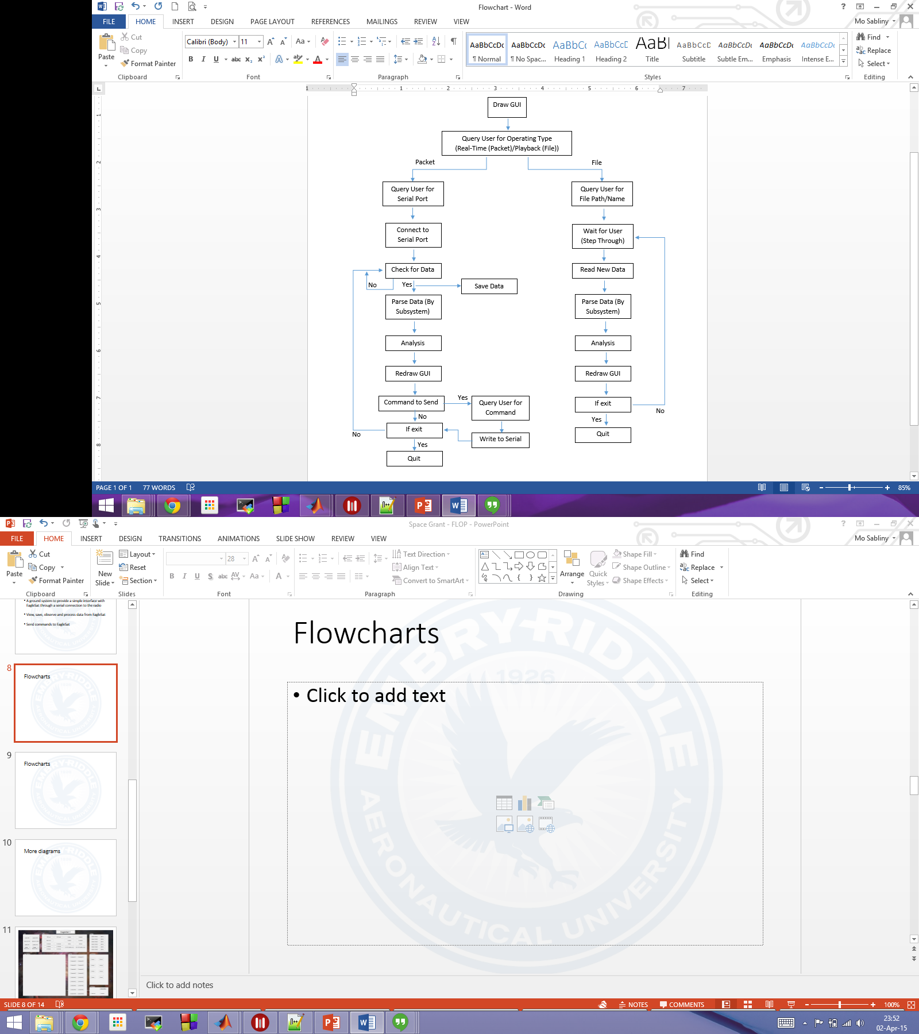
High Level Flowchart

Slide 9
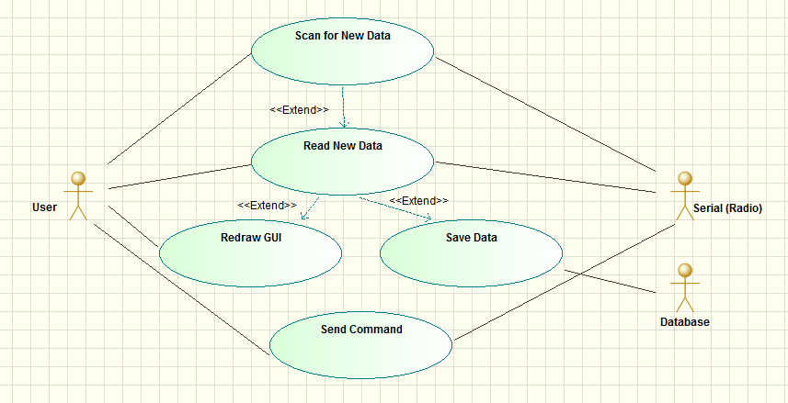
Use Case – Real Time

Slide 10
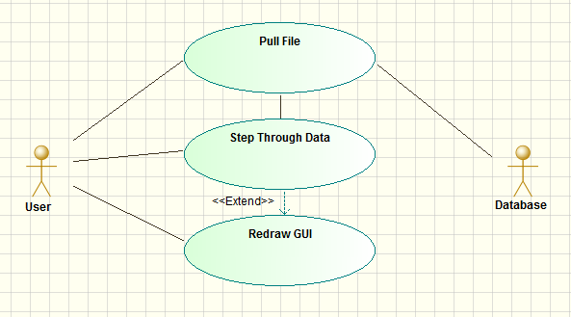
Use Case – Playback

Slide 11
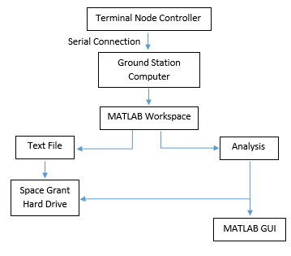
Data Flow Diagram

Slide 12
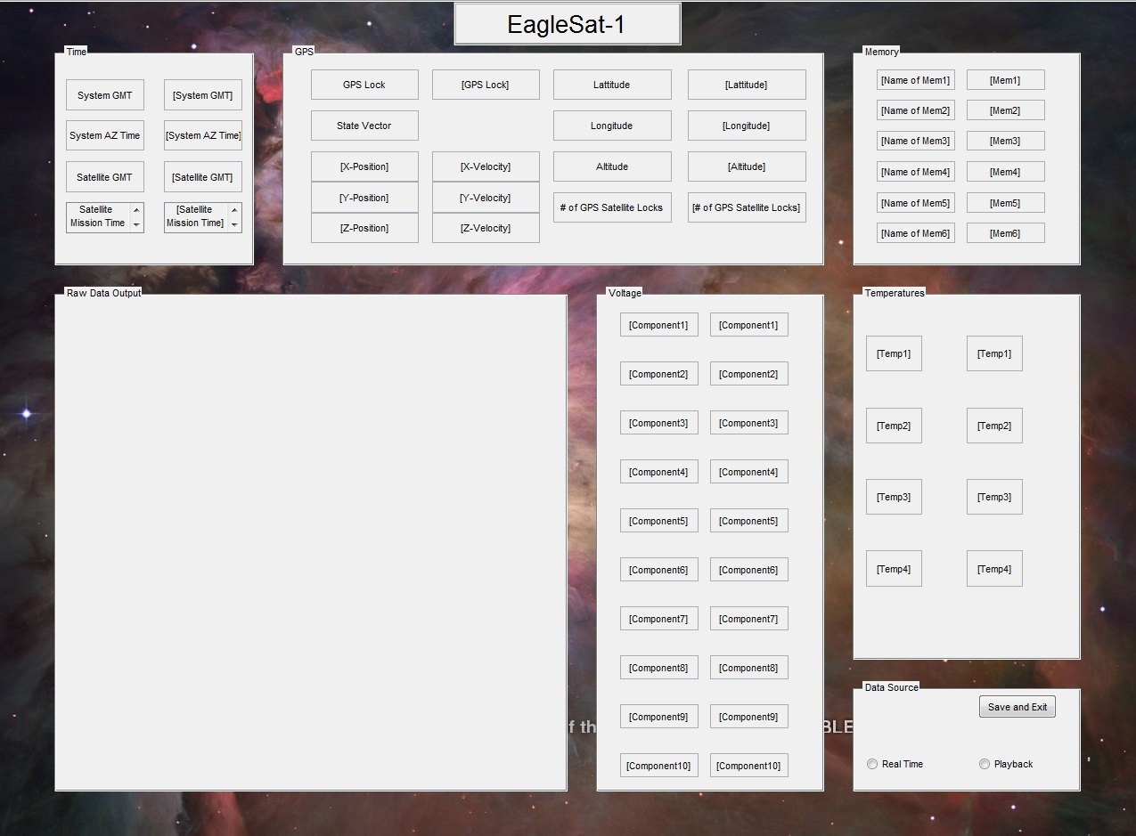

Slide 13
Progress Report
Progress Made:
  GUI prototype completed
  Parsed the packet format currently available
  High level design
    Unified Modeling Language (UML) Models
  Verified the serial connection interface with Arduino to MATLAB
To Be Completed:
  Code Construction
    Data Parsing
    Data Analysis
    Function Callbacks
  Integration of code within the GUI
  Test runs of GUI with completed code
  Verify the serial connection interface with TNC to MATLAB

Slide 14
Stretch Goals
Map memory error locations
Generate trend reports
  Graphs of data over time (e.g. weekly, monthly, quarterly, yearly)
Model/map of orbital decay

Slide 15
Questions?

